Slide 1

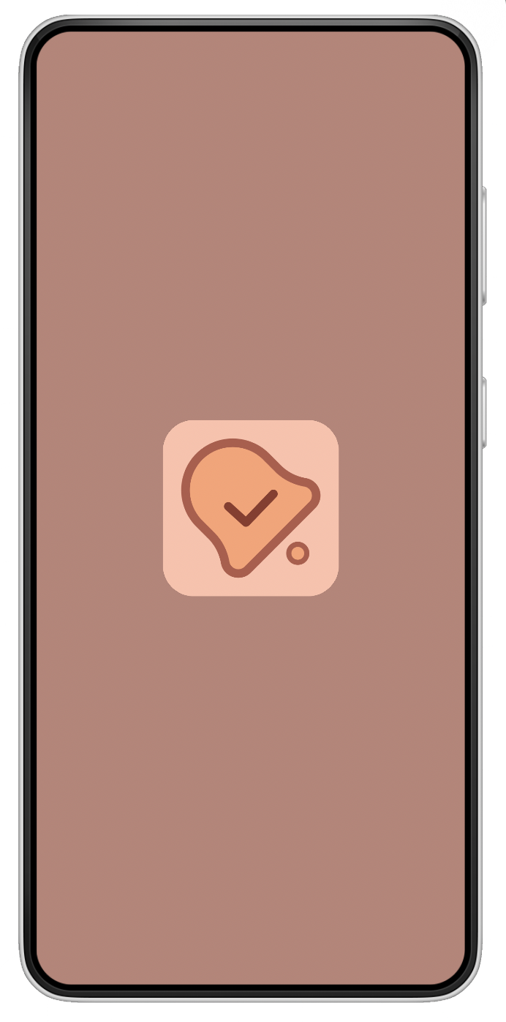

RemindMe Mobile Application Development

Slide 2



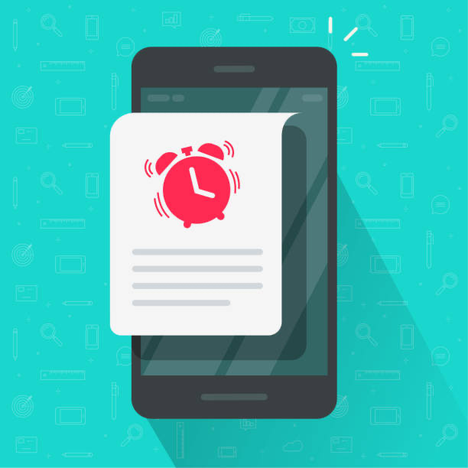
Summary
The idea of RemindMe

Slide 3
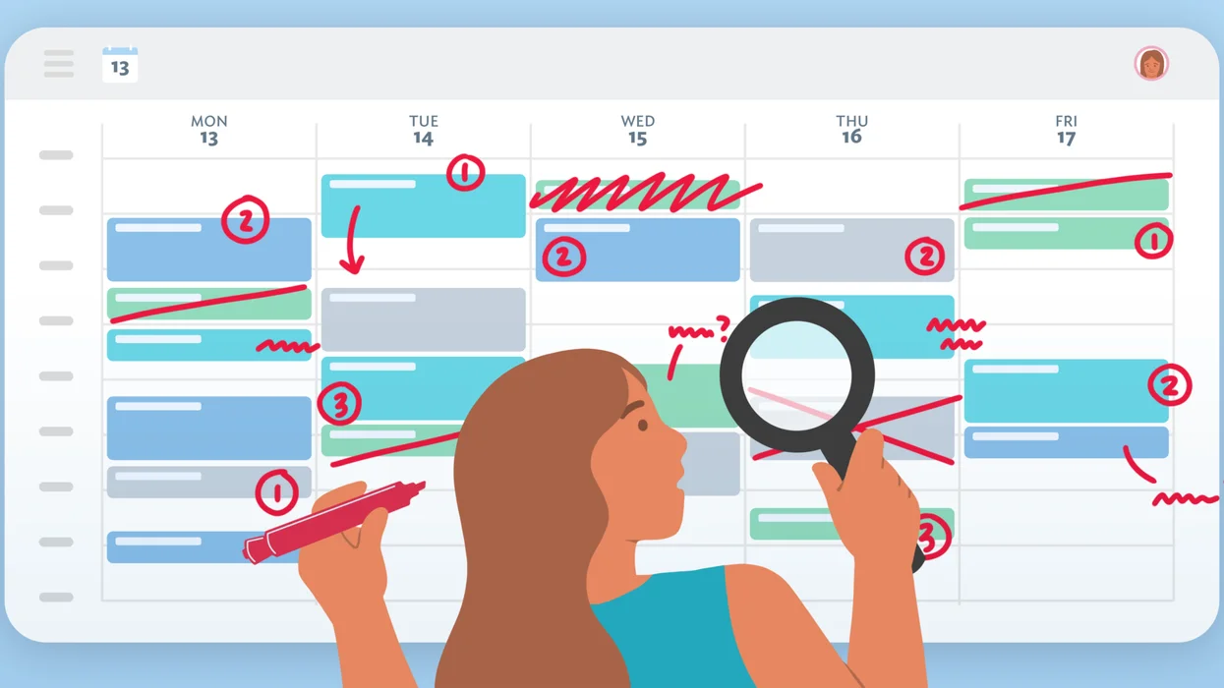


Problem
You think you can remember things in your head
Messy Schedules
Procrastination

Slide 4




Solution
Develop a Productive Mobile Application
Create Tasks
Get Notified
Collaborate
Focus

Slide 5
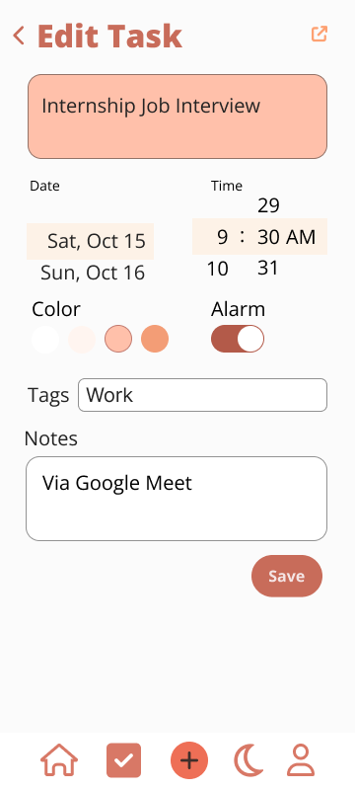
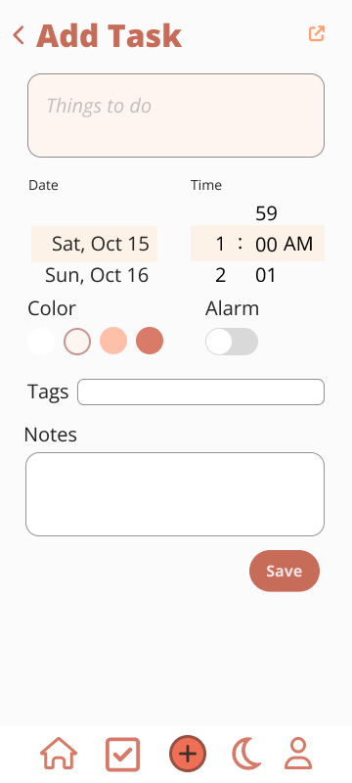
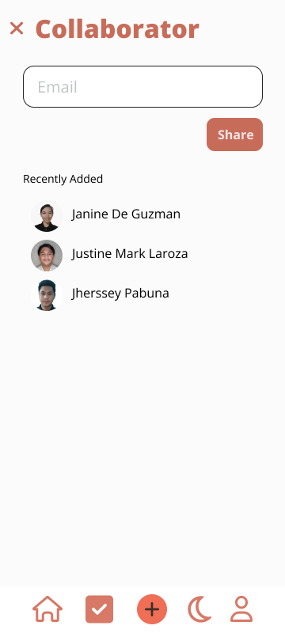
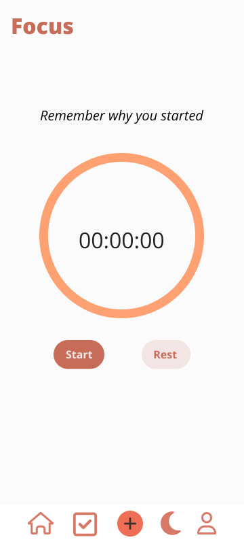
Product and Prototype
Features
Color Theme
Orange - promotes better focus, concentration, and creativity.
Red - gives energy
Alarm
Customize
Collaborate
Focus Timer

Slide 6
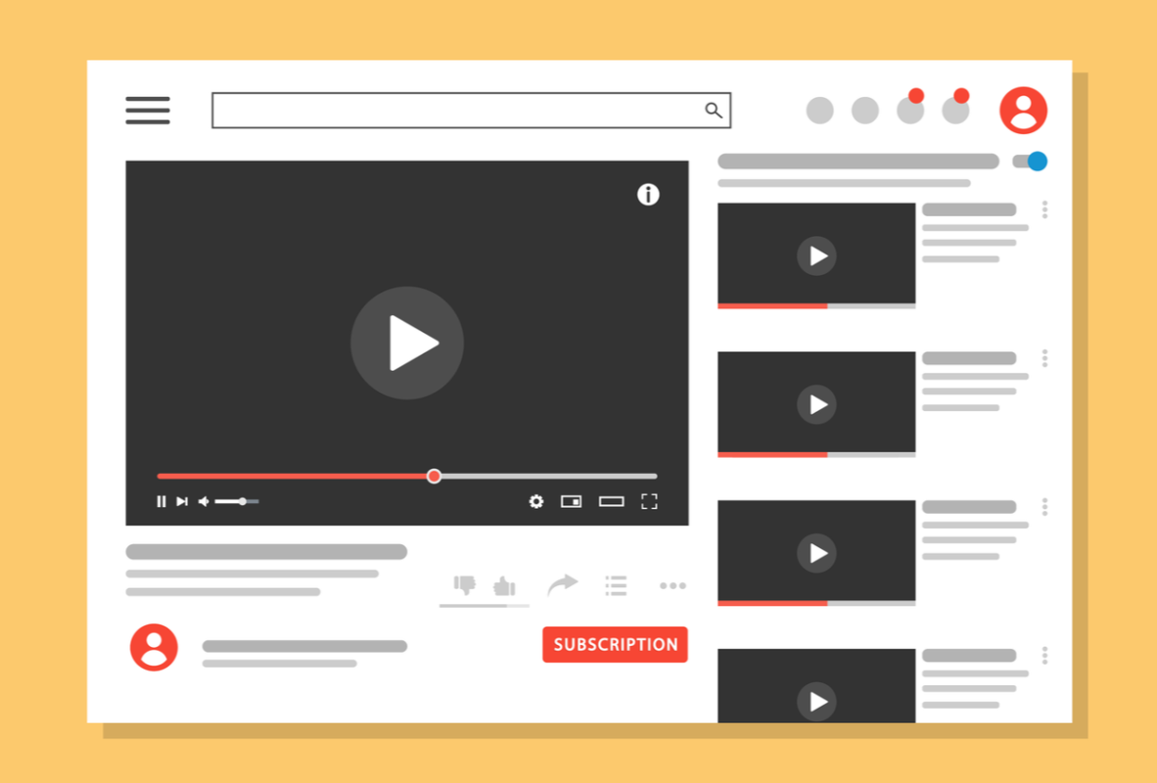
Business Model
Freemium
Advertisement
Free | Premium 7 days free trial ₱129 / monthly
✓ Create a Tasks ✓ Calendar View ✓ Alarm ✓ Add 1 Collaborator | ✓ Create a Tasks ✓ Calendar View ✓ Alarm ✓ Unlimited Collaborator ✓ Focus Timer ✓ Customize

Slide 7





Target Market
16-40 Years old
Student
Employee
Study
Work

Slide 8





Competitors
Microsoft OneNote
Notion
Evernote
ClickUp
Microsoft To Do

Slide 9
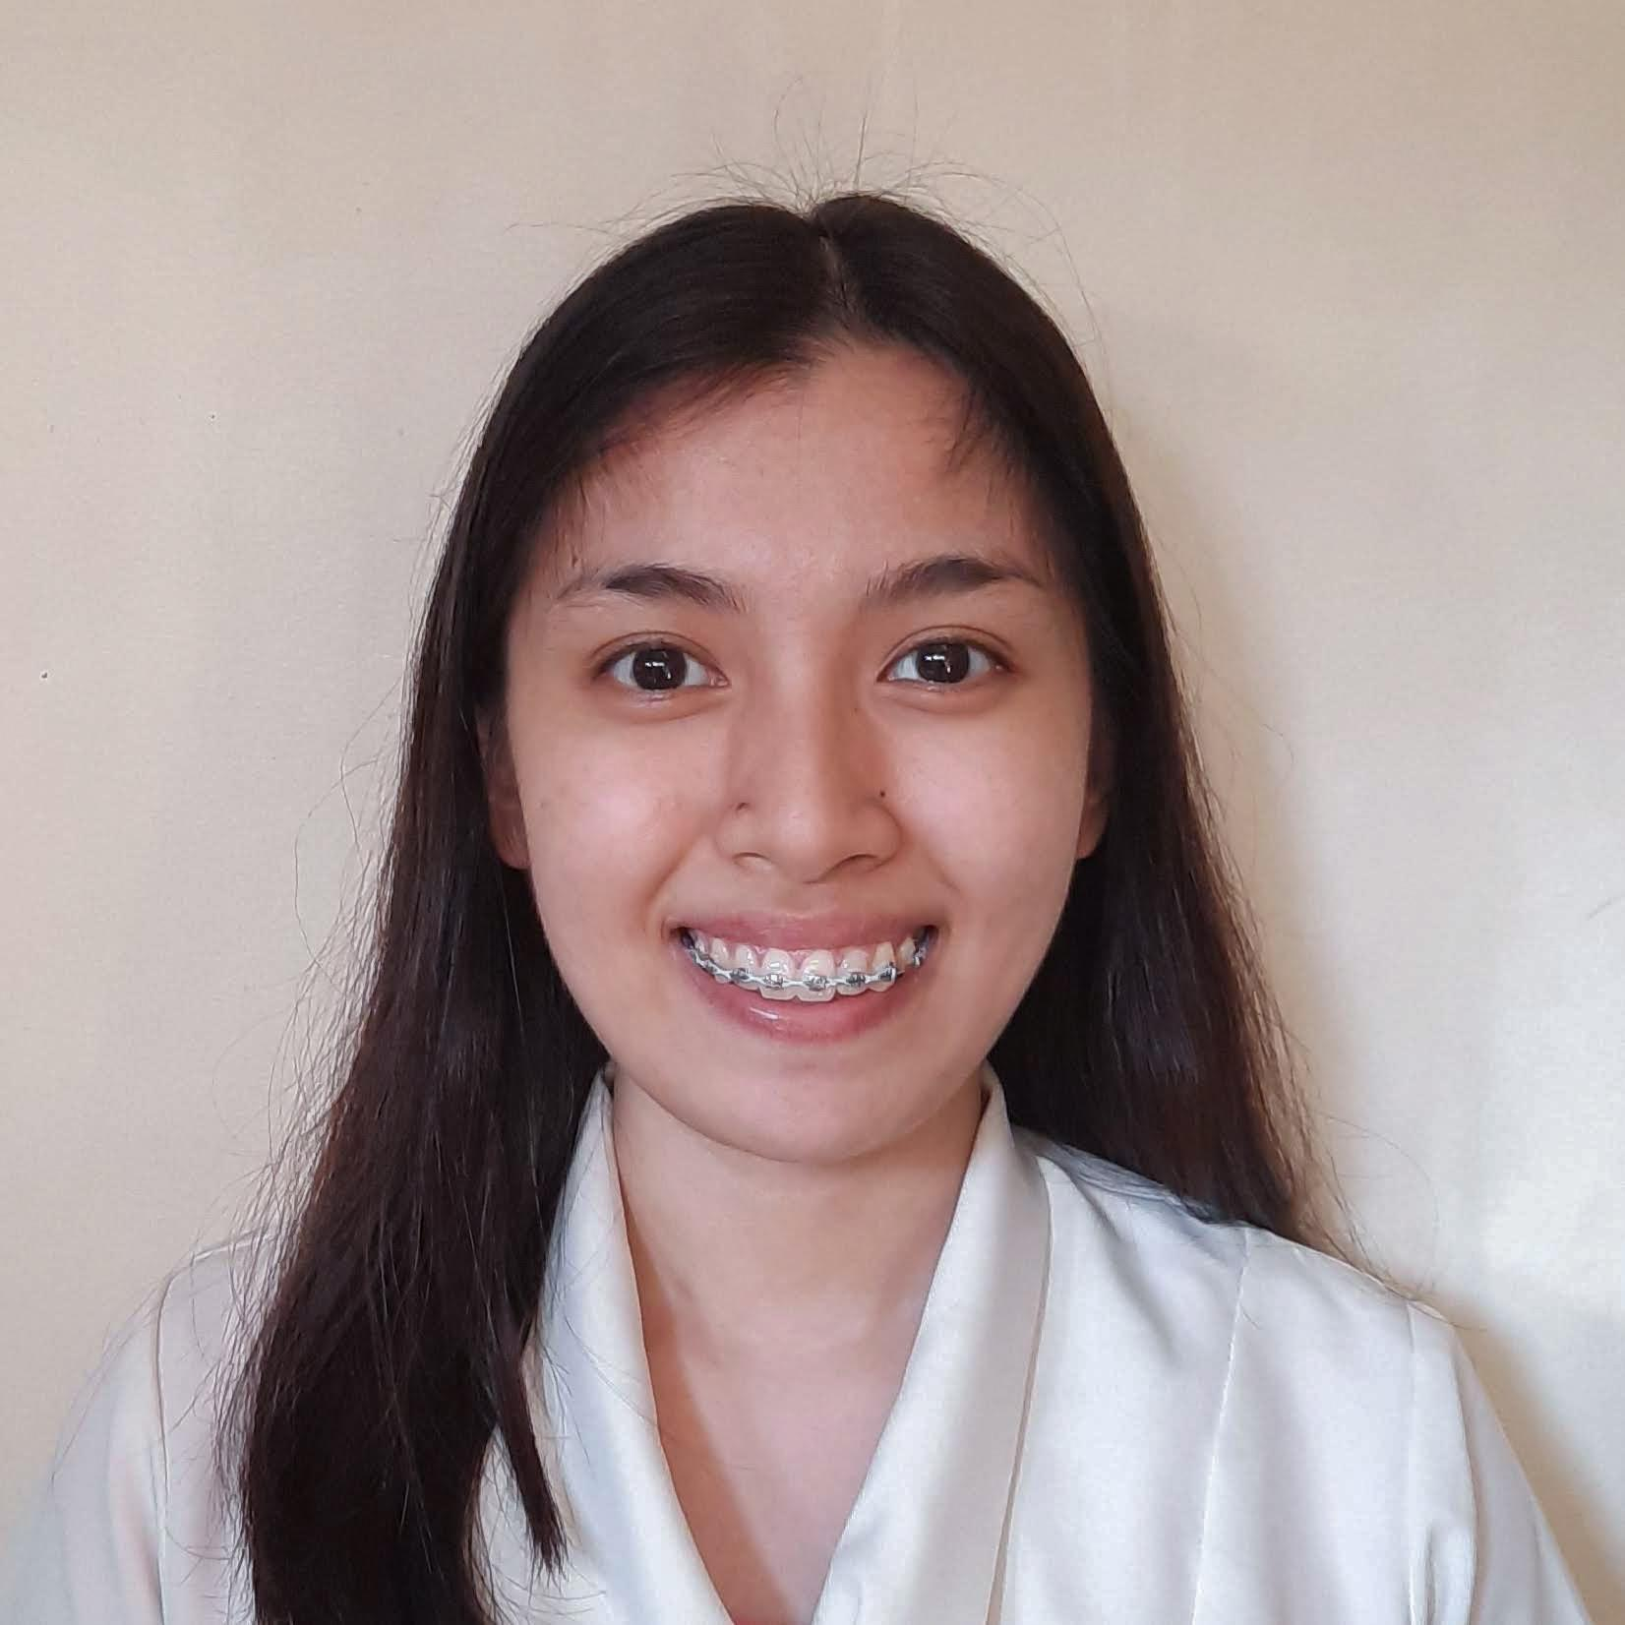
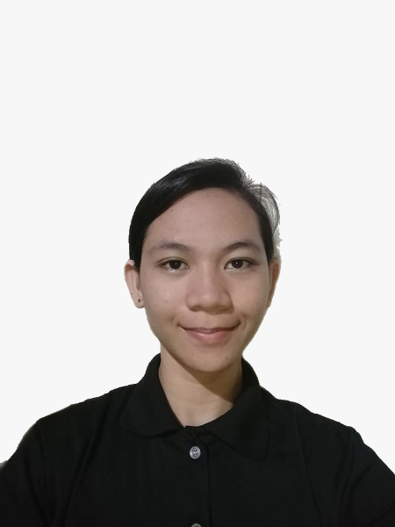
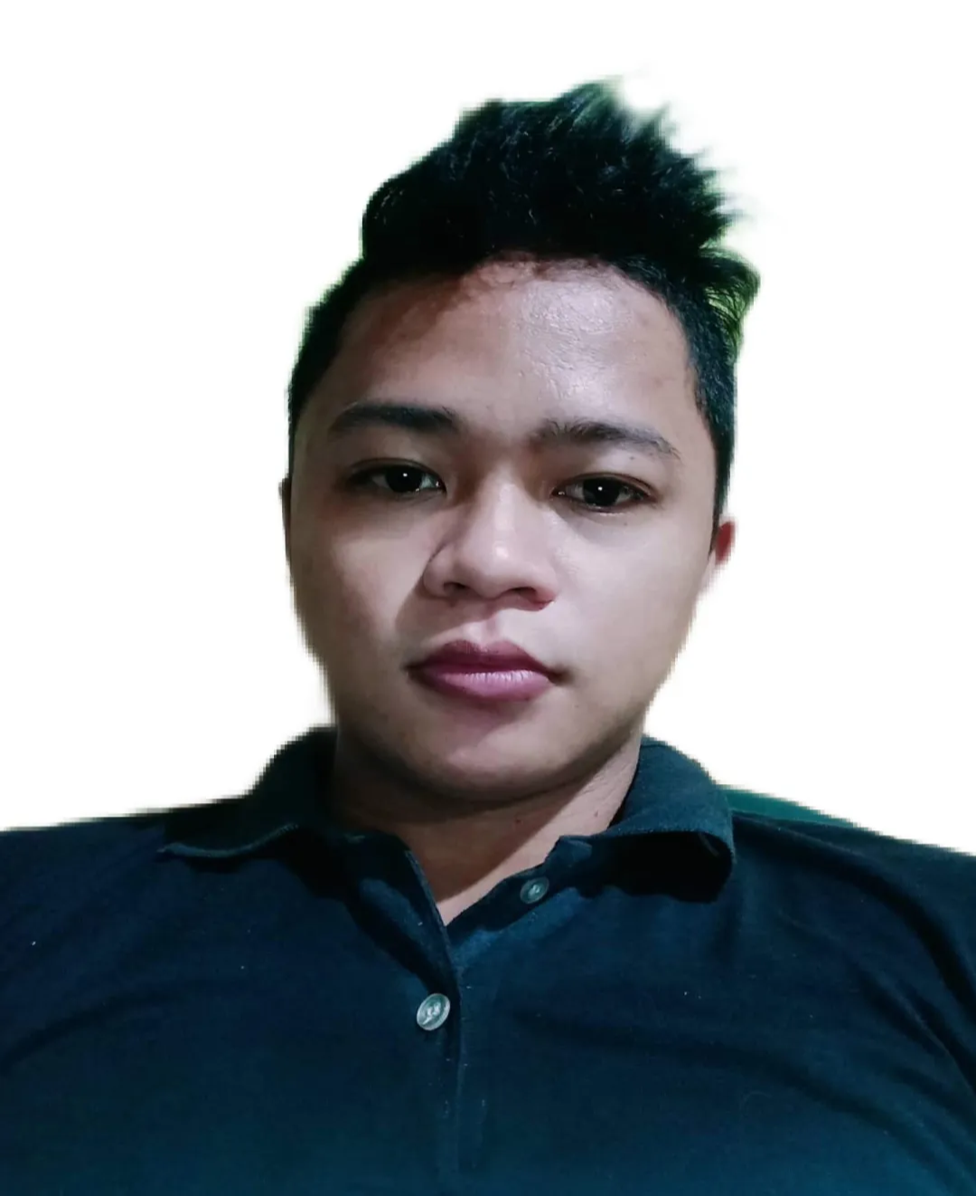
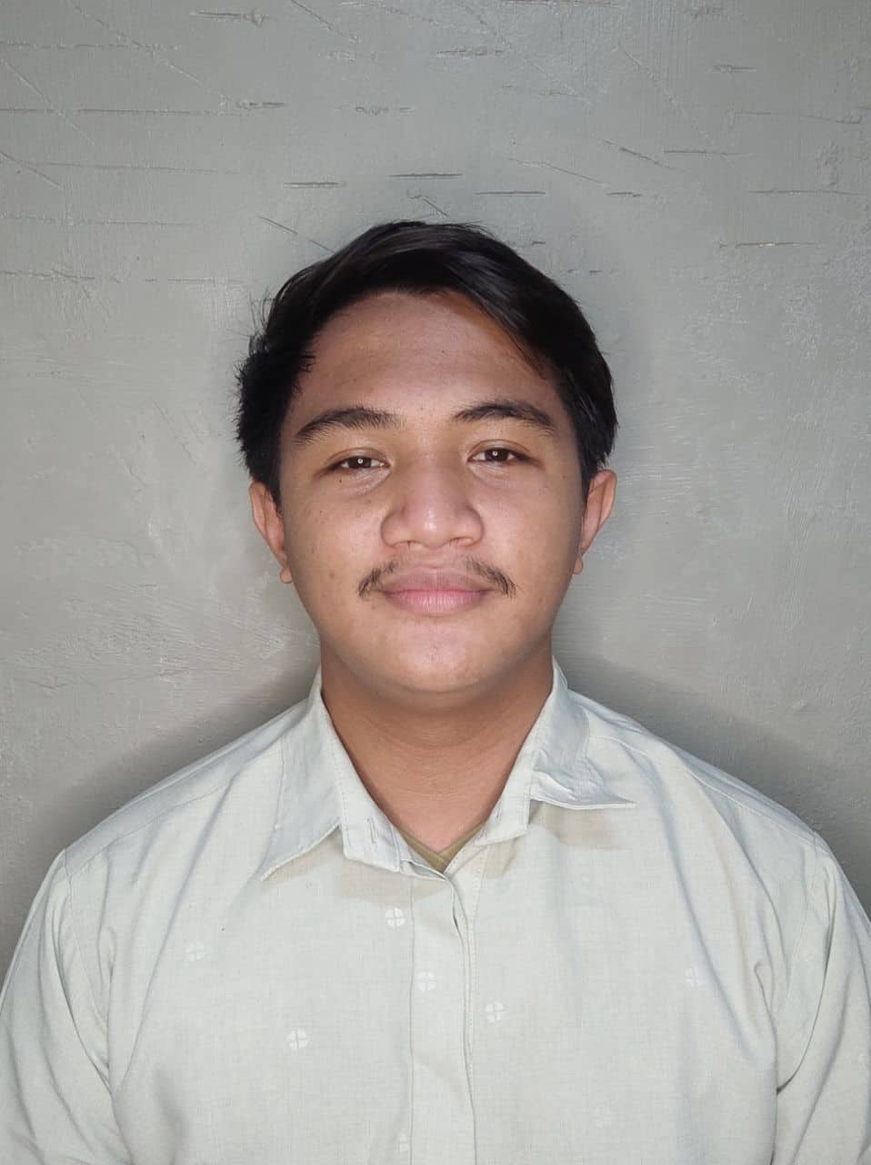
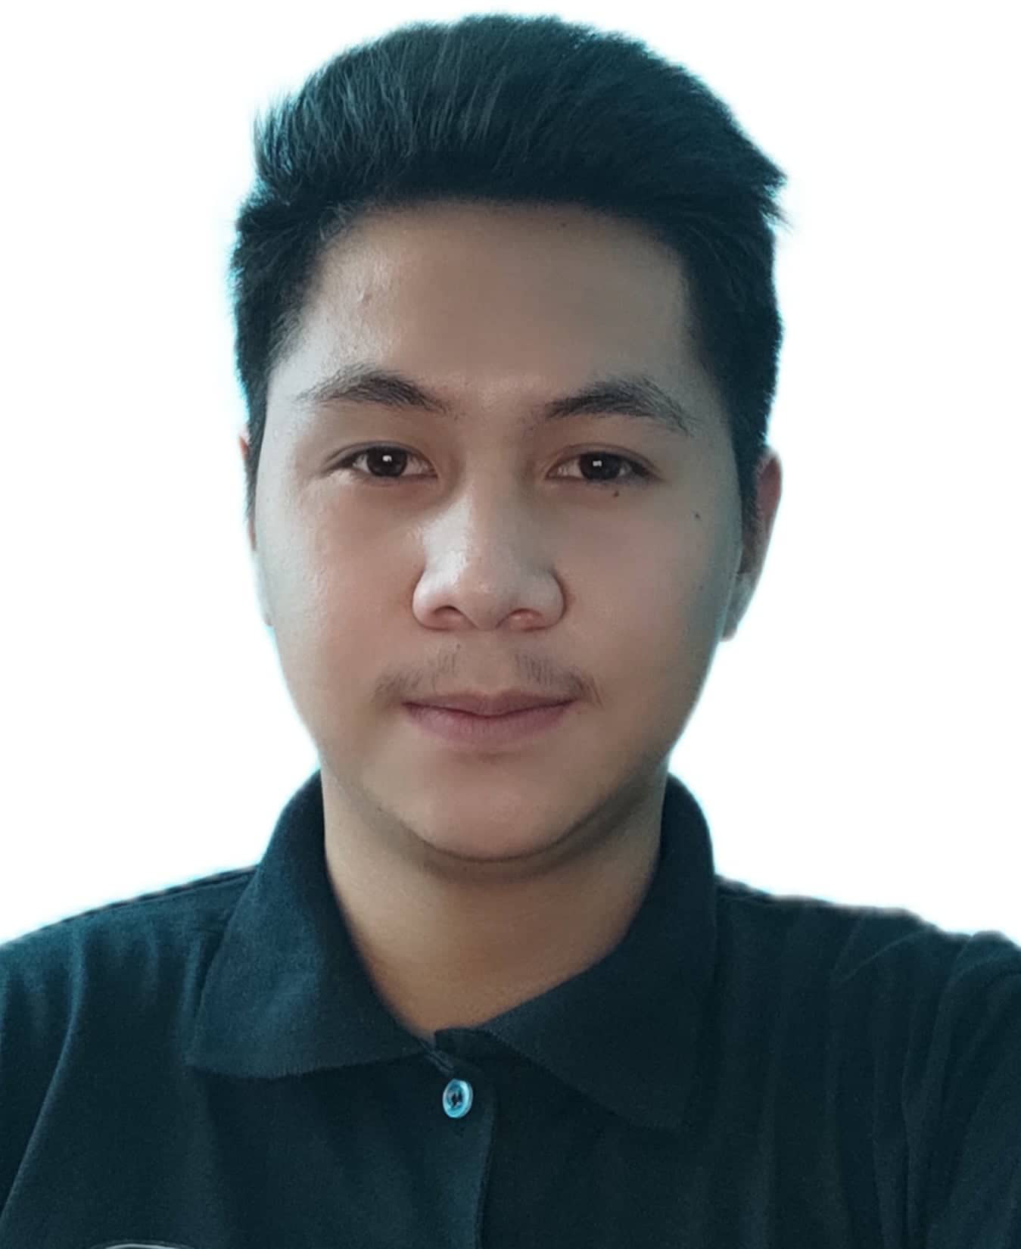

Meet the Team
Gea Vanessa C. Apeta
Project Manager, Designer
Janine E. De Guzman
Documentation
Jeffrey M. De Guzman
Developer
Justine Mark D. Laroza
Documentation
Jherssey M. Pabuna
Developer
John Michael Soliven
Tester

Slide 10


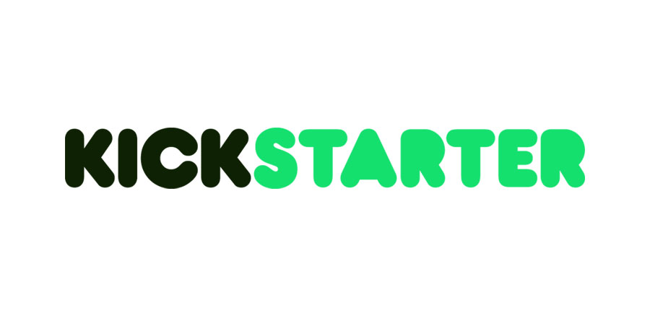
Investment and Use of Funds
Crowdfunding

Slide 11
Thank you for listening
Q & A

Slide 12
